Slide 1
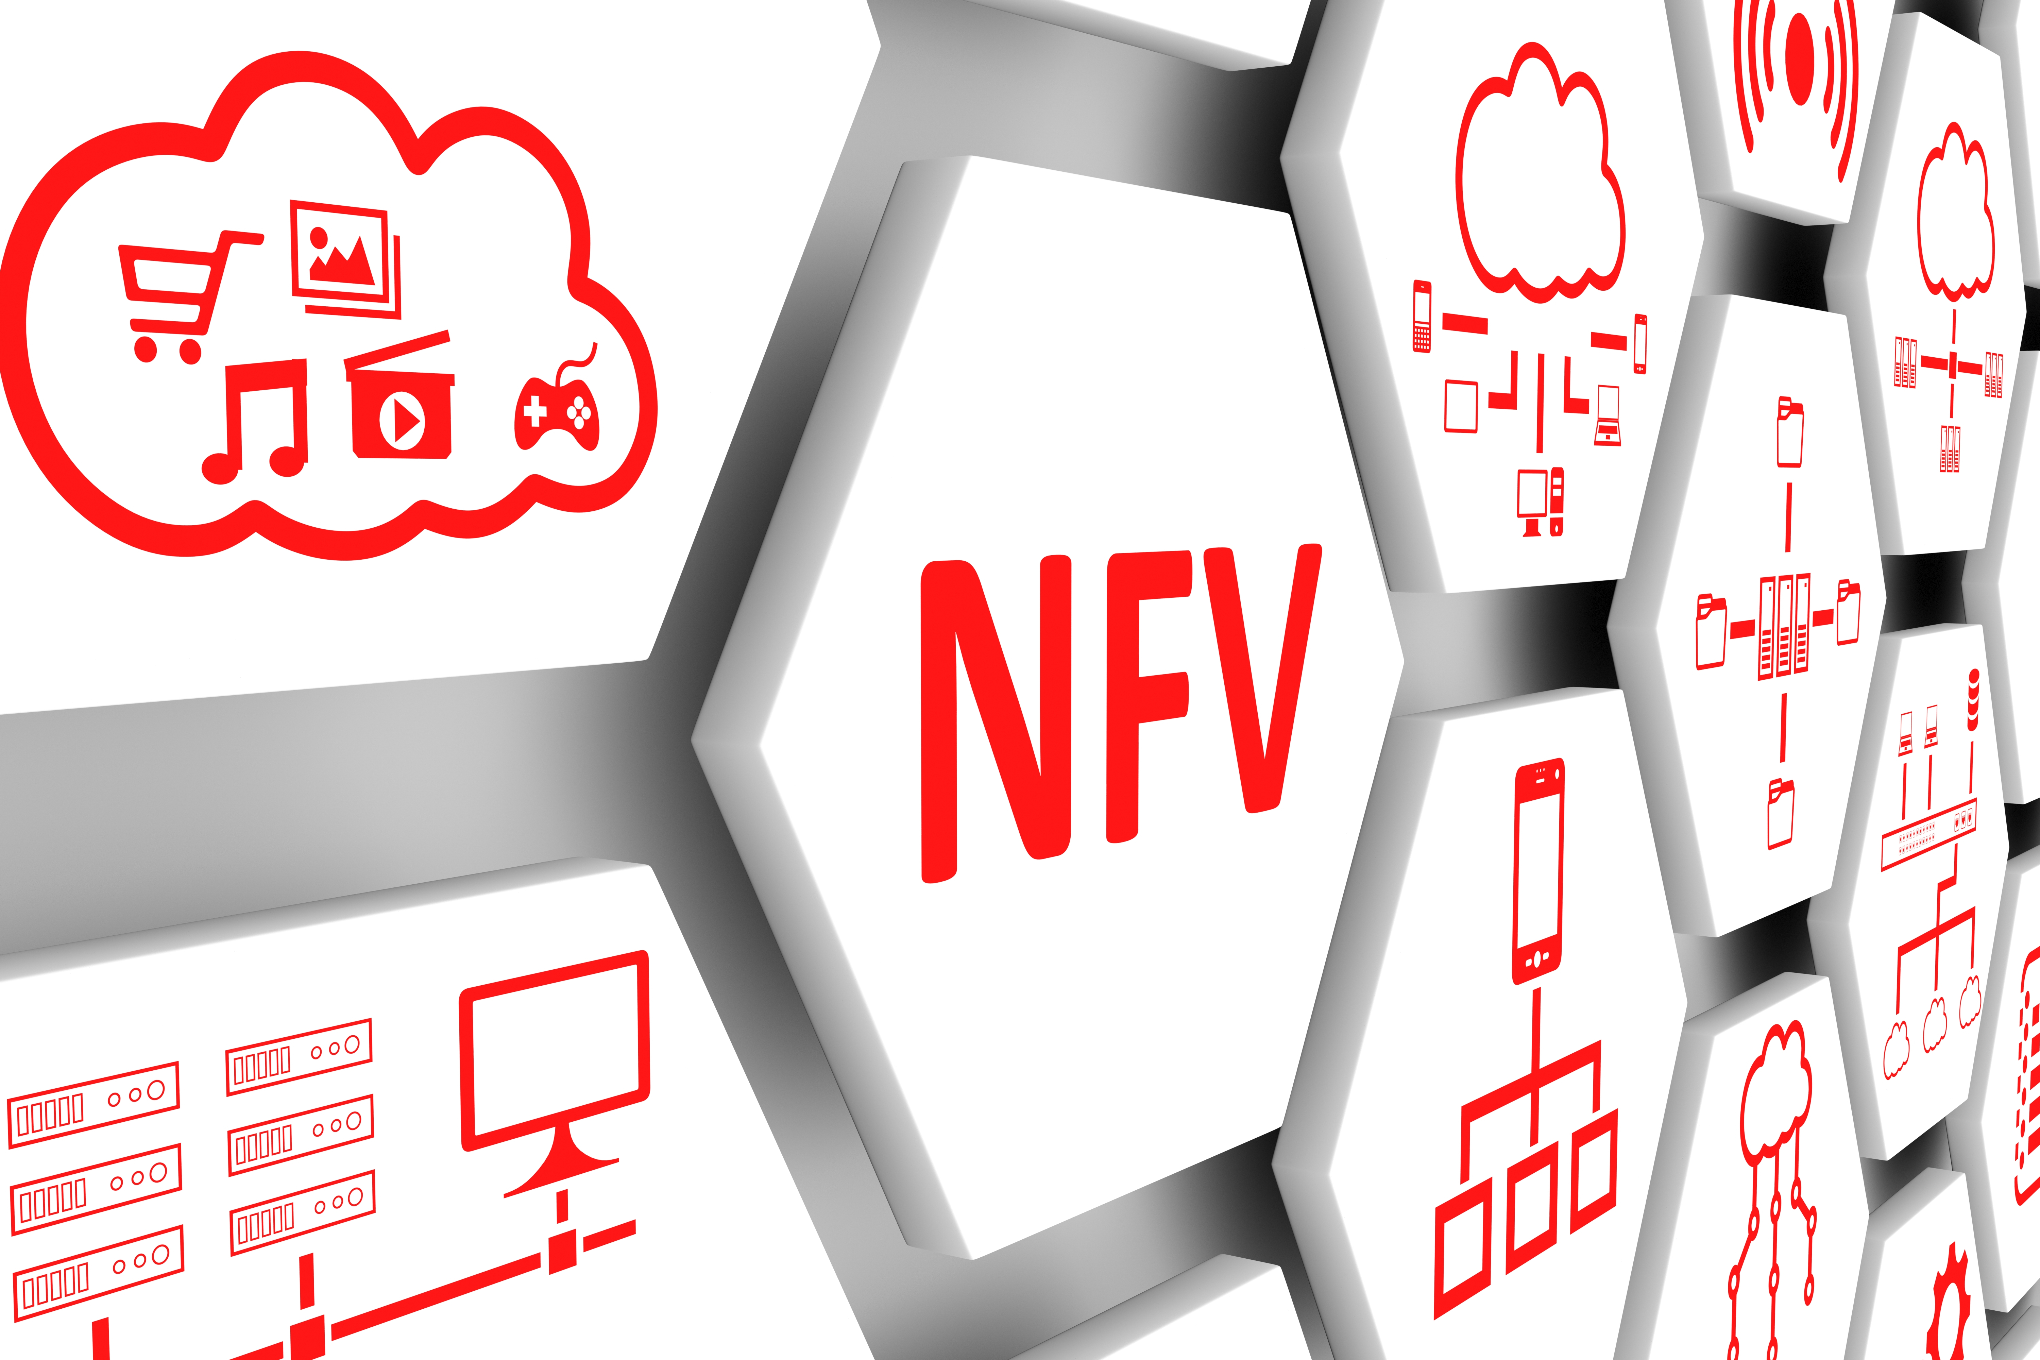




Project-Team 4
Smart Networks and Service Orchestration
ALARM MANAGEMENT
Project Presentation
Politecnico di Milano, May 30th 2020
Notes:
1

Slide 2
Outline
Architecture
GUI
Live demo
May 2020
Smart Networks and Service Orchestration - © 2020 All rights reserved
2

Slide 3
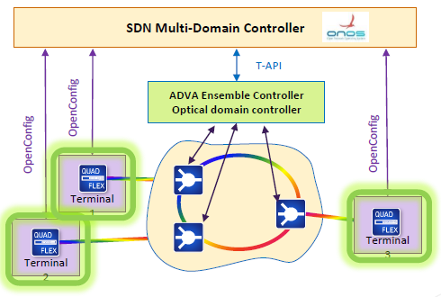
Architecture
Used Architecture from the PoliMi Lab:
In this project, we monitor and notify the alarms corresponding to the three QuadFlex Terminals provided by ADVA in the PoliMi Lab, whose Ip addresses correspond to:
10.11.12.19/24
10.11.12.21/24
10.11.12.23/24

Slide 4
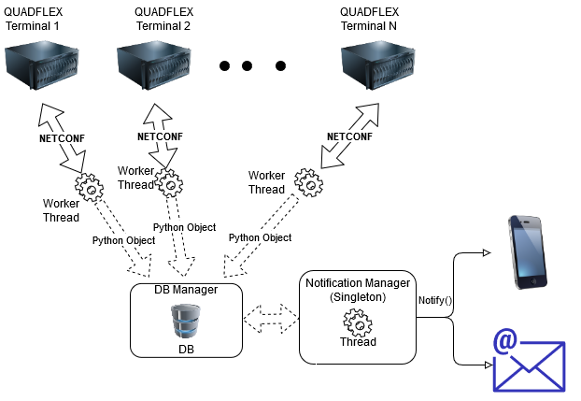
Architecture
Our Software Architecture:
Nevertheless, we go further to the previous architecture and propose a monitor alarm system for several terminals.
In our system, we instantiate a thread for each terminal.
Using the NETCONF-based interface, we retrieve the information of the alarms of each terminal to the Data-Base manager, and further on to the Notification manager.

Slide 5
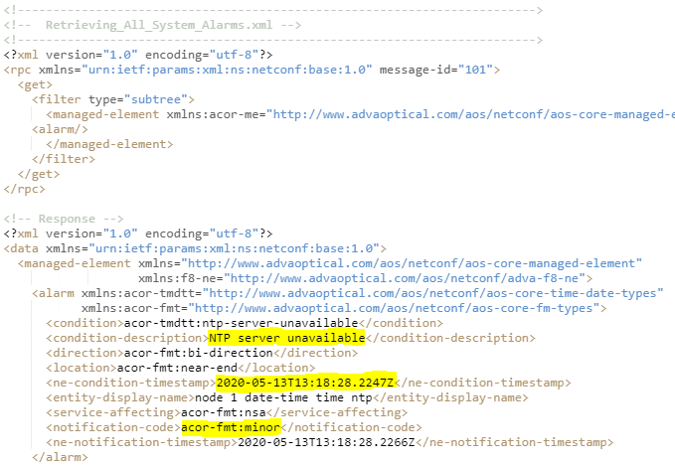
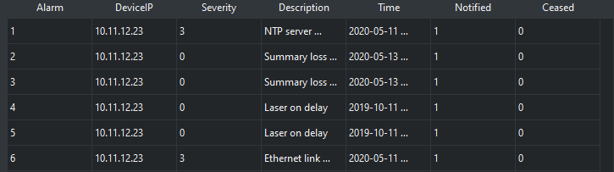
Data Base Manager
We took:
Condition Description, Time stamp, and Notification Code from the XML response.
The Notification Code can be
"critical": 5
"major": 4
"minor": 3
"warning": 2.
"not-alarmed": 1
"not-reported": 0

Slide 6
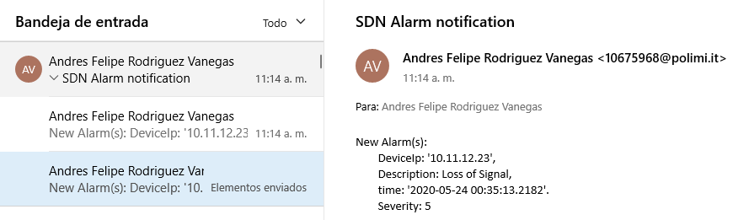
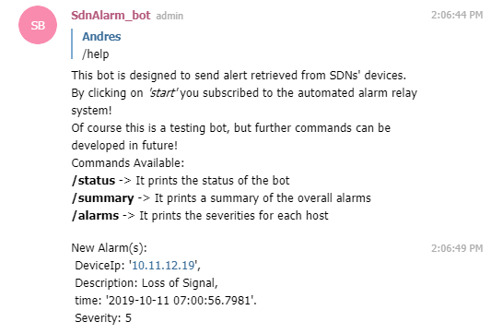
Notification Manager
Notification via e-mail
Notification via Telegram Bot

Slide 7
Outline
Architecture
GUI
Live demo
May 2020
Smart Networks and Service Orchestration - © 2020 All rights reserved
7

Slide 8
Graphical User Interface
Implemented using PyQt5
With the Graphical User Interface it is possible to interact with our project in two different moments:
Before our analysis starts:
Edit the notification parameters: i.e. which type of notifications we want to receive and the consequential credentials needed
Add new devices that will be taken into account during the evaluation

Slide 9
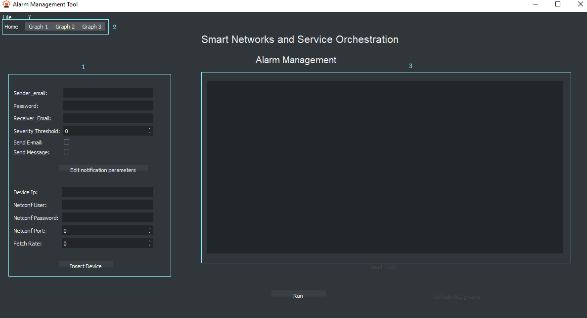

Slide 10
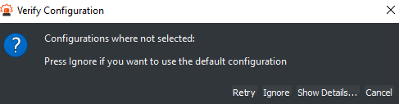
Graphical User Interface
2. During the analysis after we confirm our choices into the Run button window:

Slide 11
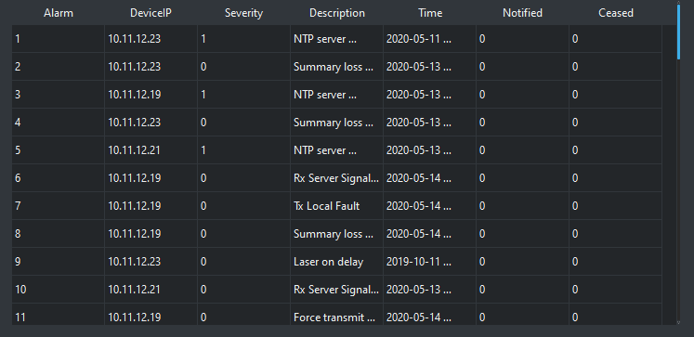
Graphical User Interface-During the analysis
Load Table: it fetches the content from the DB table whose values refer to the last update performed by the Worker Threads

Slide 12
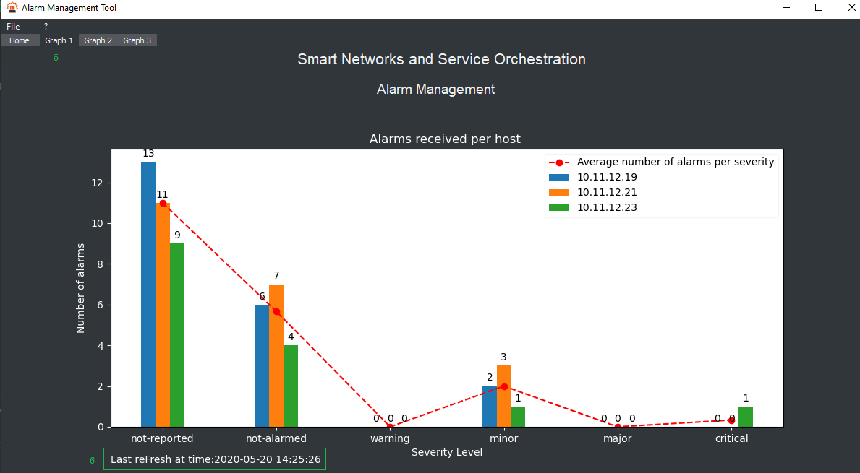
Graphical User Interface-During the analysis
Refresh All Graphs: it retrieves the proper data from the DB table and updates consequently the graphs in the three tabs:
The graphs inside the GUI have been created using matplotlib
In each graph tab there is an indication about the last refresh time
Graph1:

Slide 13
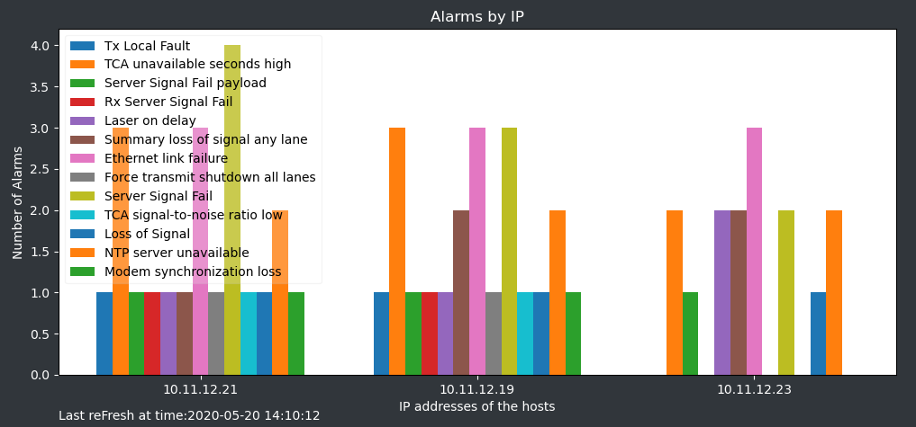
Graphical User Interface-During the analysis
Refresh All Graphs - Graph 2:

Slide 14
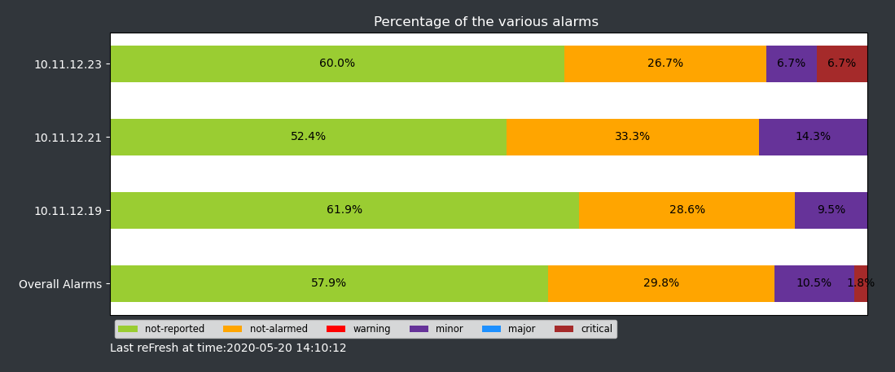
Graphical User Interface-During the analysis
Refresh All Graphs - Graph 3:

Slide 15
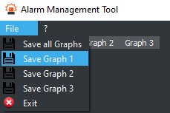
Graphical User Interface-During the analysis
Save: it is possible to save either a subset or all the graphs such that a post-analysis and an evaluation of the process can be performed even after we close the GUI

Slide 16
Outline
Architecture
GUI
Live demo
May 2020
Smart Networks and Service Orchestration - © 2020 All rights reserved
16

Slide 17
Live Demo
Telegram bot information:
Open your telegram application and search: @SdnAlarm_bot
Start the bot
The bot will send a message where there is a link to a telegram group: open it
May 2020
Smart Networks and Service Orchestration - © 2020 All rights reserved
17

Slide 18
THANKS
Question time
Contacts:
Fabio Carminati: fabio3.carminati@mail.polimi.it
Emanuele Gallone: emanuele.gallone@mail.polimi.it
Andrés Rodriguez: andresfelipe.rodriguez@mail.polimi.it

